Slide 1
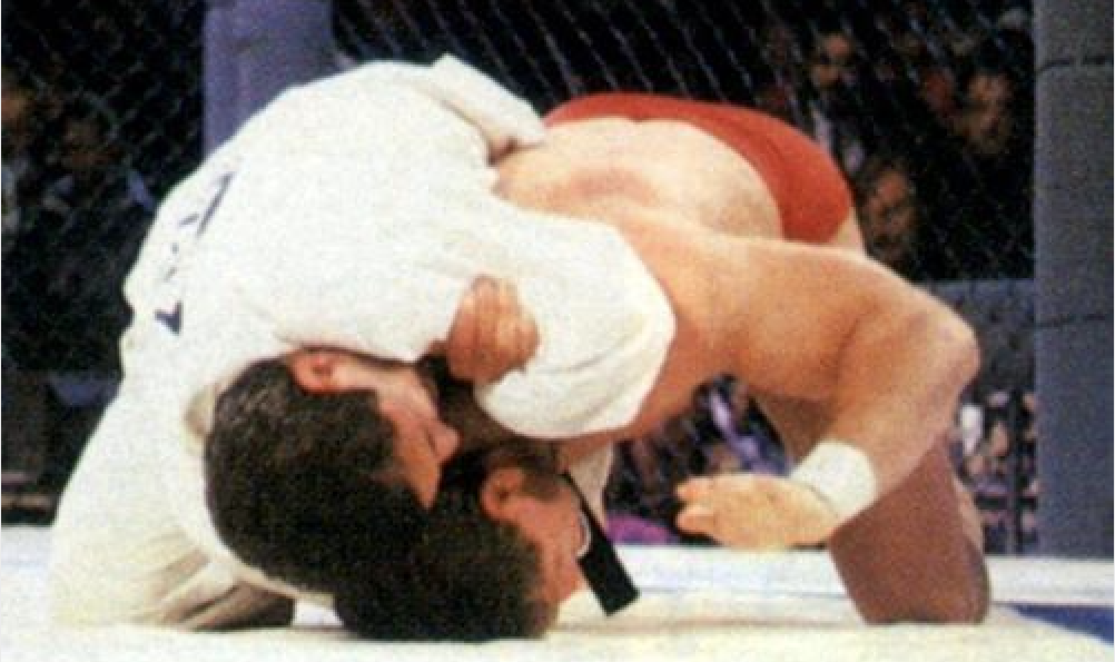
Blockchain: The Brazilian Jiu-Jitsu of Web 3.0
J Davis

Slide 2
ABOUT.ME
BS in Mathematics
MS in Computer Science
PhD in Information Systems
Tech Entrepreneur
Partner @ MaxBoring (largest crypto mining venture in Louisiana)
Teach data science, machine learning, agile methods, & app development
jamesdavis@lsu.edu
linkedin.com/in/jdavisphd/

Slide 3
WHAT IS BLOCKCHAIN?

Slide 4
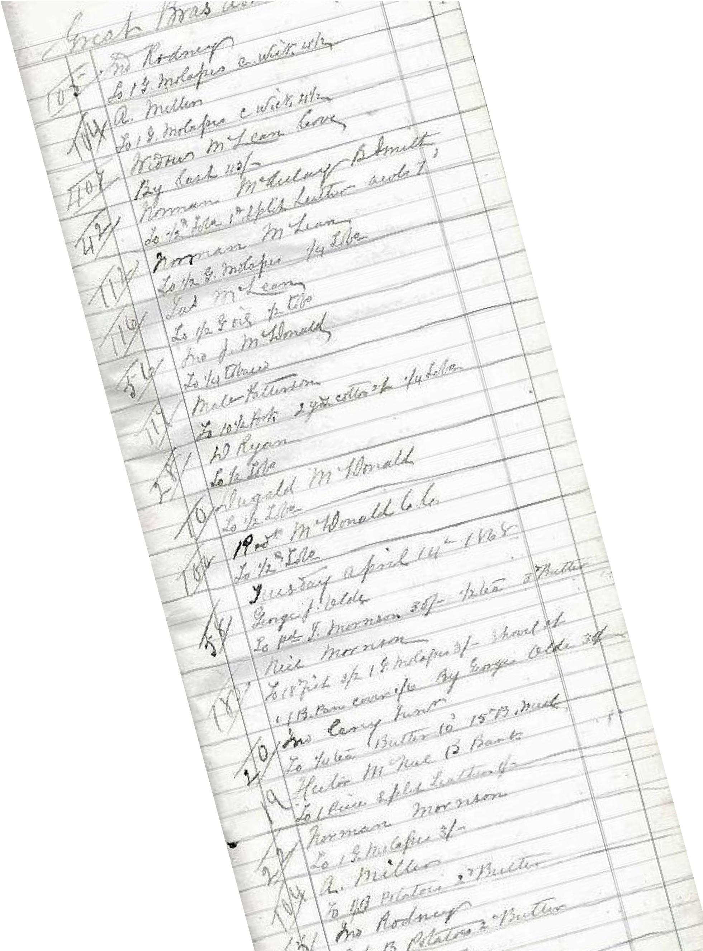
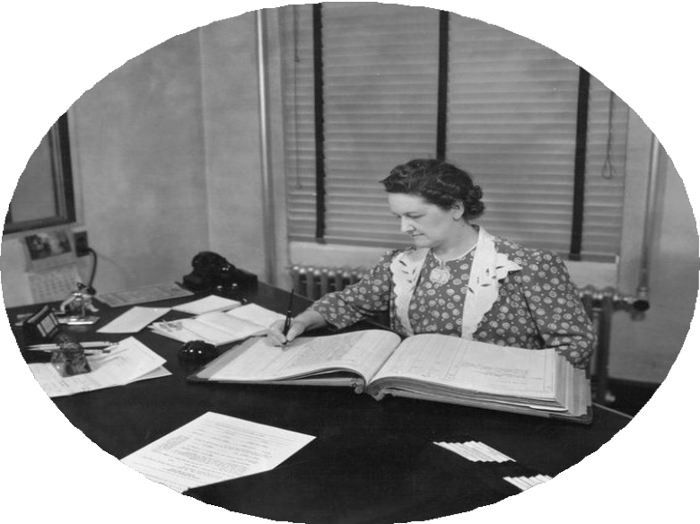
IT’S A LEDGER.

Slide 5
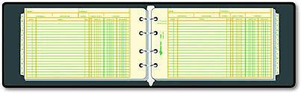
- Keeps everything in chronological order
ATTRIBUTES
- Only moves in one direction
“Chain”
Like the binding of a ledger to keep blocks together
“Blocks”
Each block
is like a page in the
ledger

Slide 6
A block’s hash is the results of SHA-256 algorithm on block data Slight changes to the block and the hash changes significantly
ATTRIBUTES(cont)
“Hash”
Blocks contain the hash of the previous block
Each block
contains data usually about transactions

Slide 7
IMMUTABILITY
Unchangeable because everyone has a copy of it.

Slide 8
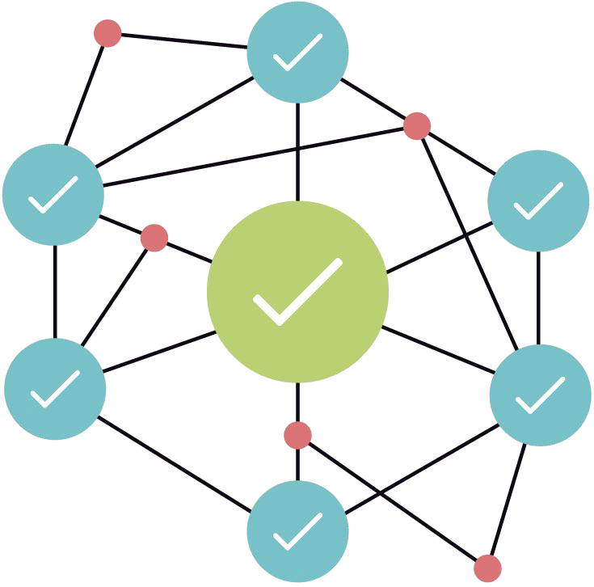
NODES

Slide 9

TRANSPARENT

Slide 10
- Transparency keeps it from being tampered with
CHECKS AND BALANCES
- Is this transaction feasible?
- Anyone can go backwards and check the history

Slide 11

ALWAYS FORWARD

Slide 12
WHAT IF YOU MADE A
MISTAKE?
You can’t change the past. You can only make changes going forward with the next transaction.

Slide 13
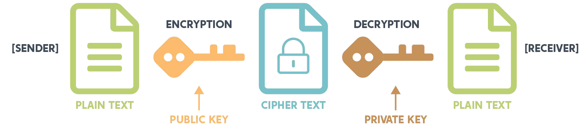
PUBLIC KEY CRYPTOGRAPHY

Slide 14

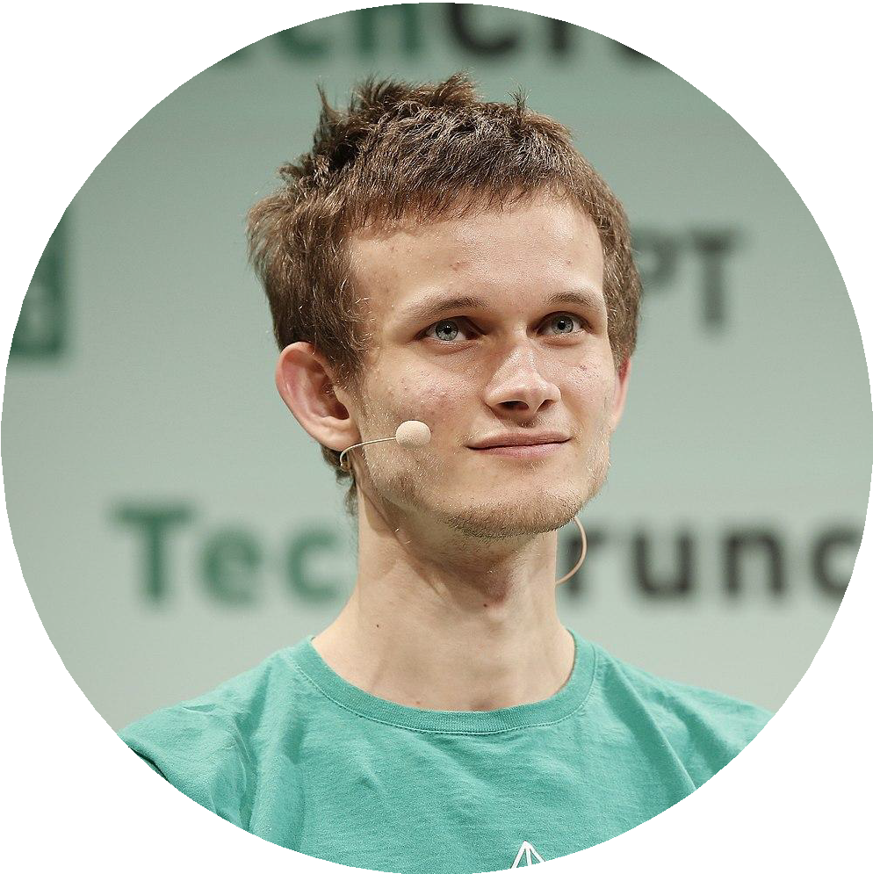

Slide 15
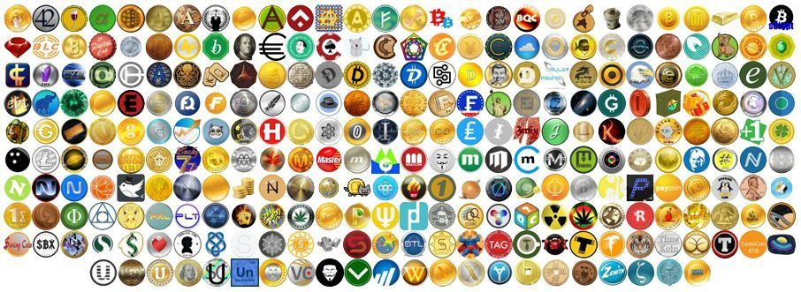
OVER 20,000 CRYPTOCURRENCIES

Slide 16
READY FOR MORE?
Blockchain is so much more than BitCoin, Ether, and all the other Cryptocurrencies.

Slide 17
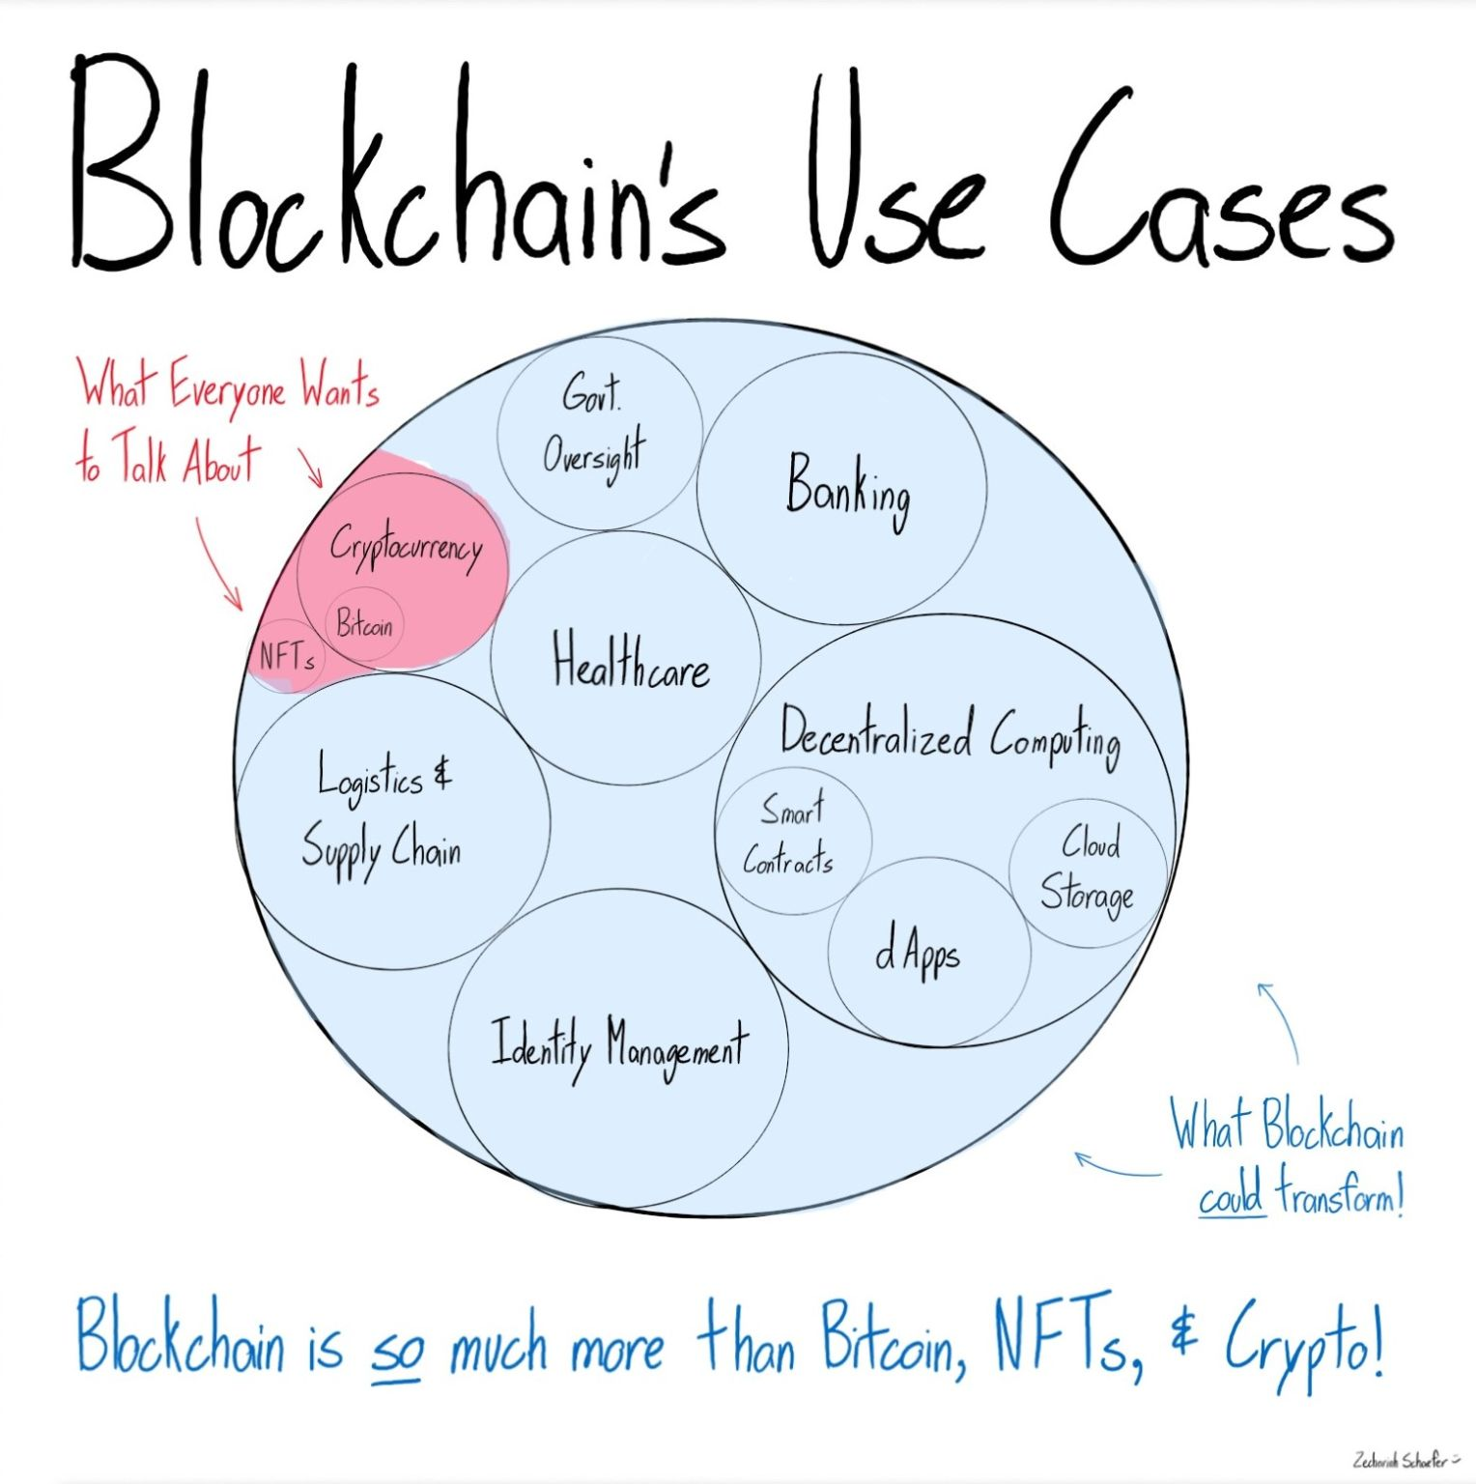
FUTURE OF BLOCKCHAIN

Slide 18
MELDING OF BUSINESS AND TECHNOLOGY

Slide 19
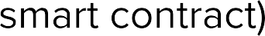

Slide 20
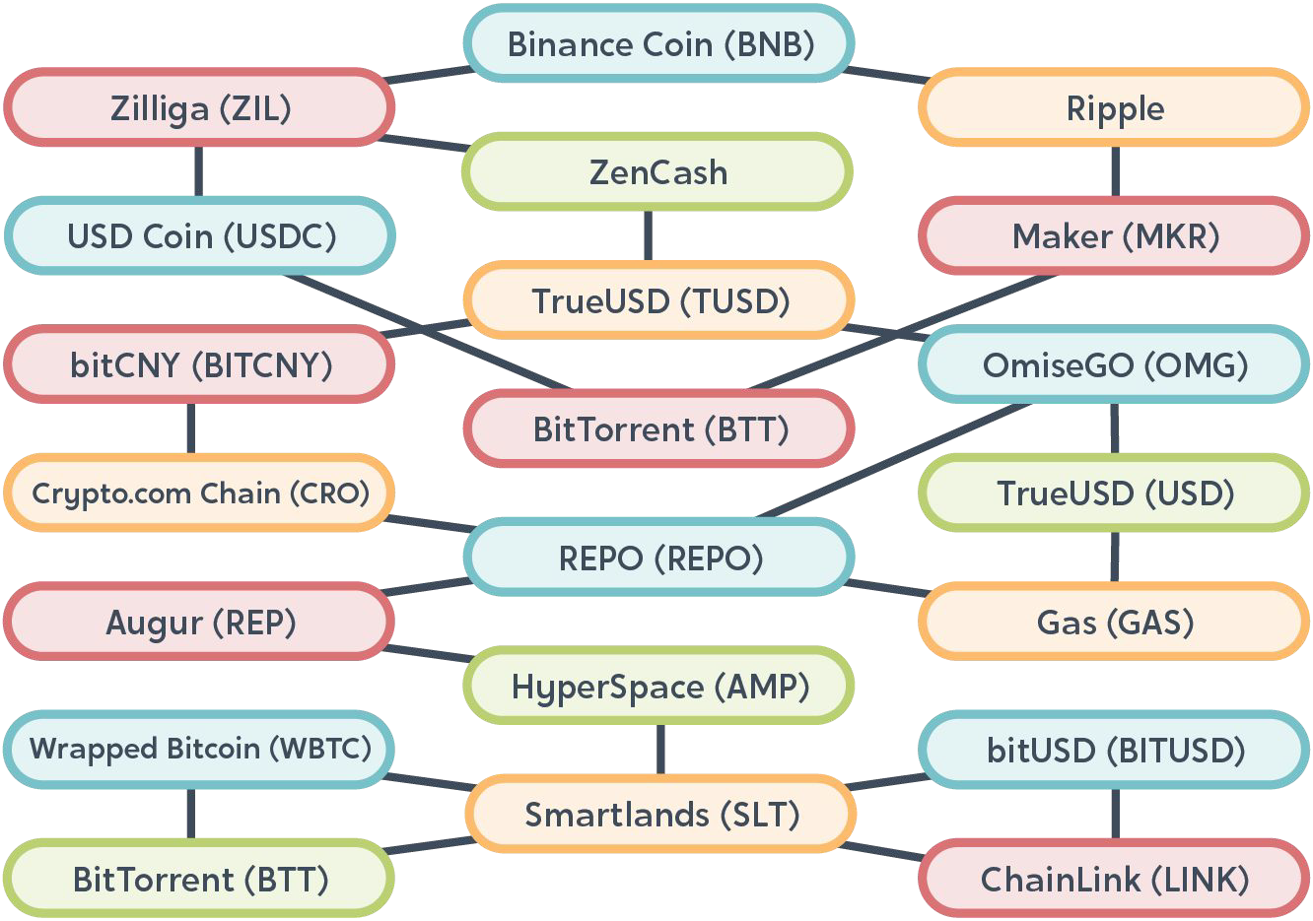

Slide 21




Slide 22
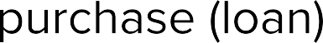
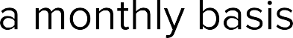


Slide 24
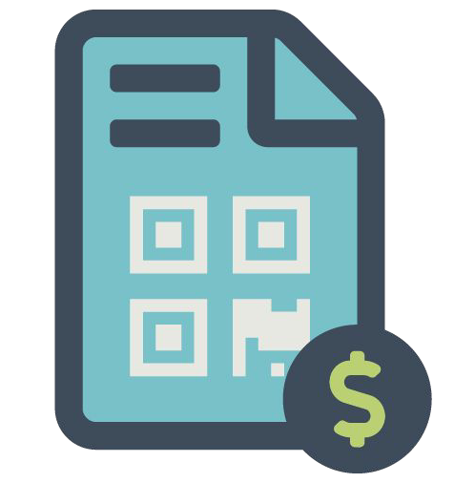
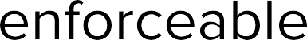

Slide 25
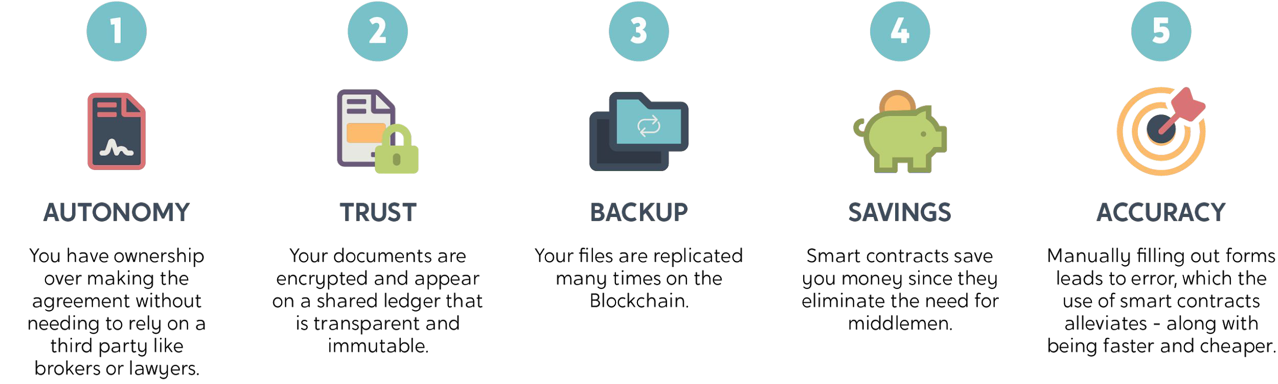
BENEFITS OF SMART CONTRACTS

Slide 26
SMART VS TRADITIONAL
SMART CONTRACT
Code
Enforced through Blockchain Created by users and programmers
Facilitates activities Reasonably inexpensive
TRADITIONAL CONTRACT
Hard copy
Legally enforceable Created by law ﬁrms Provides direction
Can be very expensive

Slide 27
- Tokens are smart contracts in most cases
TOKENS
They can represent a variety of things in which we have embedded value
Each token is diﬀerent
- There is a small basis of comparing values of diﬀerent tokens

Slide 28
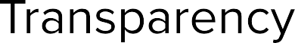


Slide 29


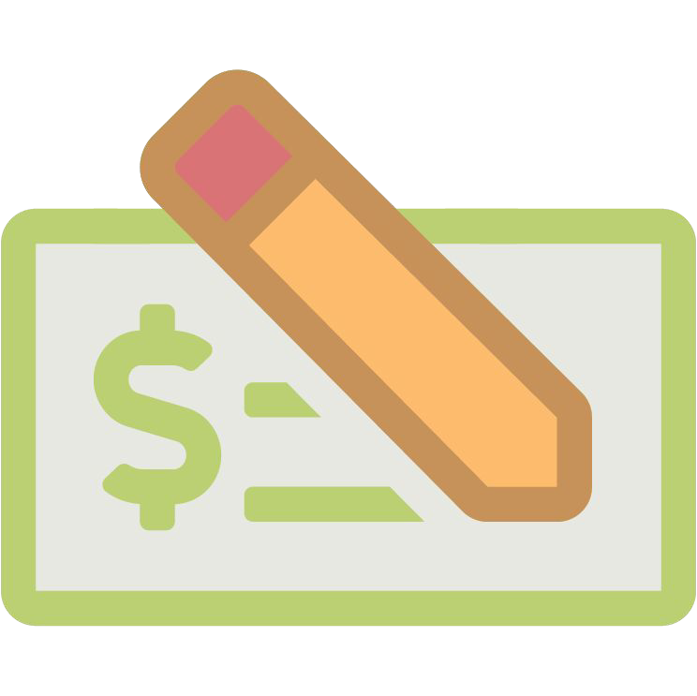
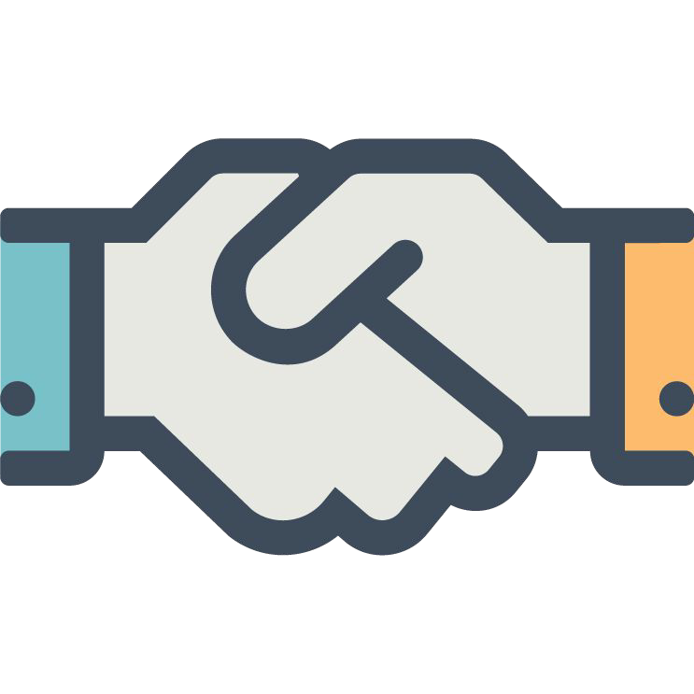
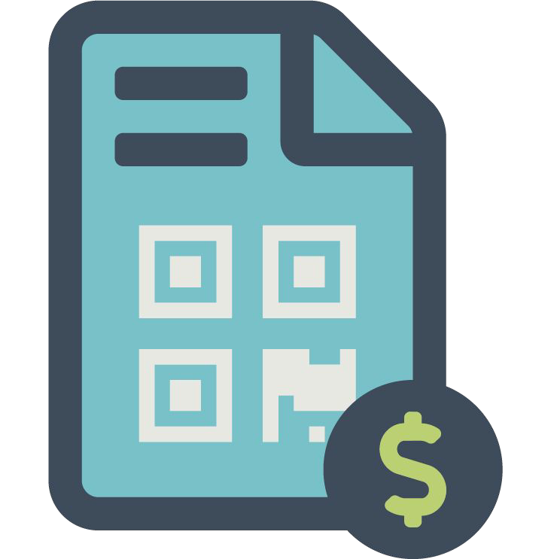



Slide 30
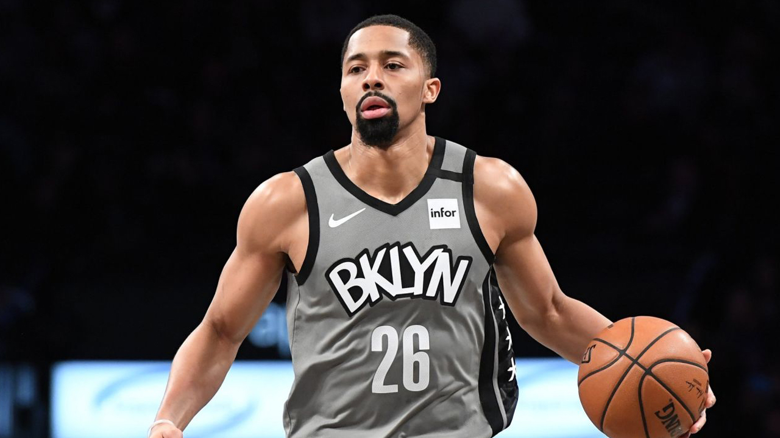

Slide 31
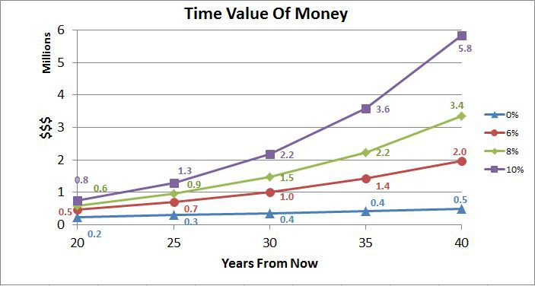
●
●
●
●
●

Slide 32
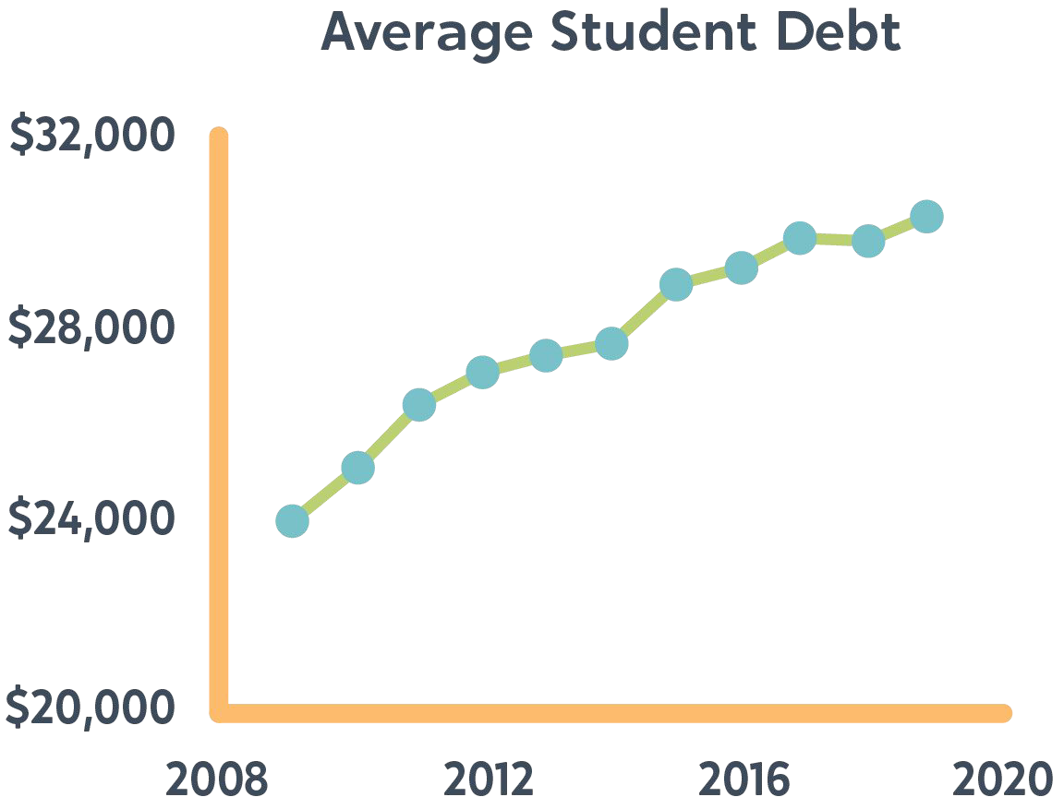
AVERAGE TOTAL DEBT OF GRADUATES WHO TOOK OUT LOANS

Slide 34
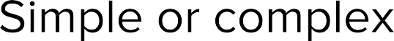
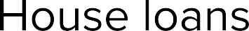
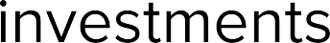
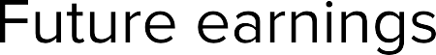
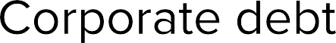

Slide 35
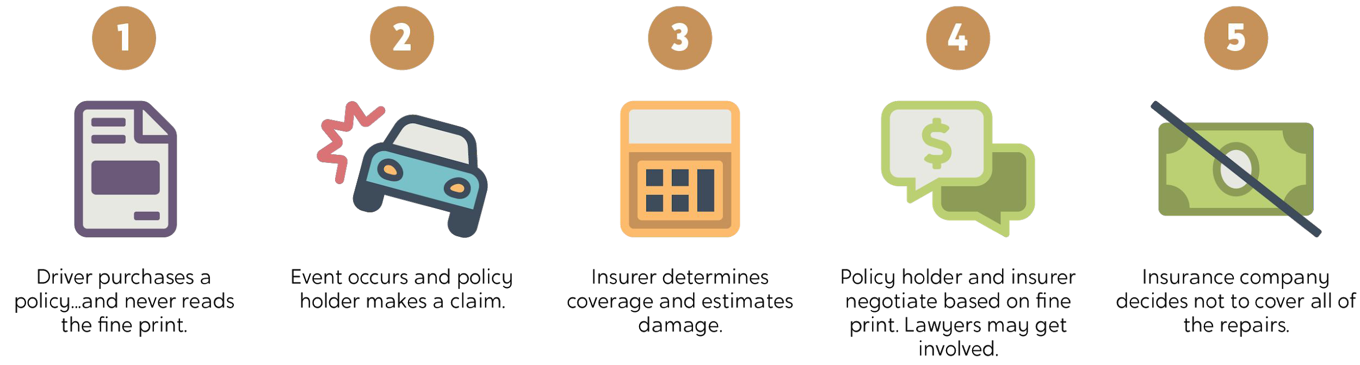
EXAMPLE
Insurance claim
- What if we could automate these kinds of things?

Slide 36
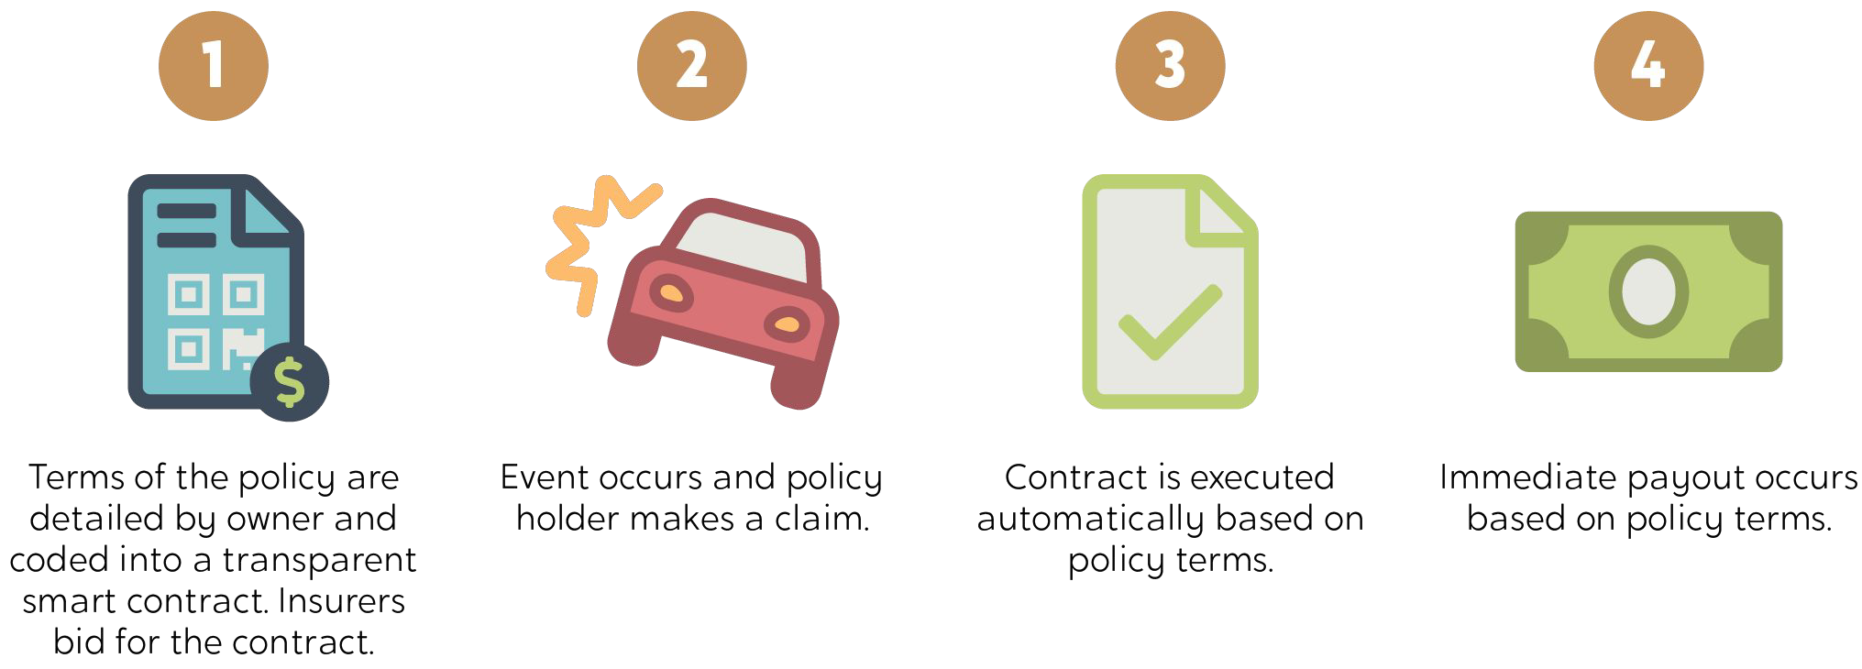

Slide 37
OPEN UP YOUR CONSIDERATIONS
BLOCKCHAIN ADDS
New ﬁnancial opportunities and business models
BLOCKCHAIN REMOVES
Friction and middlemen Centralized control

Slide 39
WHAT’S NEXT?
Creating and deploying a smart contract.
It has real business application.

Slide 40



Slide 42
RESOURCES USED IN PRESENTATION
https://agilephd.com/blockchain.html
https://metamask.io/
https://remix.ethereum.org/
https://www.hyperledger.org/use/fabric
https://aws.amazon.com/blockchain/
https://news.bitcoin.com/nba-point-guard-spencer-dinwiddies-tokenized-contract-raises-1-3-million/
https://github.com/cavalryjim/devfestbr2022

Slide 43
INTERESTED IN BUILDING BLOCKCHAIN SOLUTIONS
If you have experience in one or more of (AWS, Python, React) and you are interested in an internship and/or job, please email: james@relief.health

